Slide 1
Data Analytics
Lecture – 2
Sumita Narang

Slide 2
Objectives
Defining Analytics
Types of data analytics
Descriptive, Diagnostic
Predictive, Prescriptive
Data Analytics – methodologies
CRISP-DM Methodology
SEMMA
BIG DATA LIFE CYCLE
SMAM
Analytics Capacity Building
Challenges in Data-driven decision making

Slide 3








What is Analytics?
Which car should I buy?
Good? Or Evil?
Doctor: What medical
treatment should I recommend?
What route should I follow today?
What grades can I expect in this course?

Slide 4
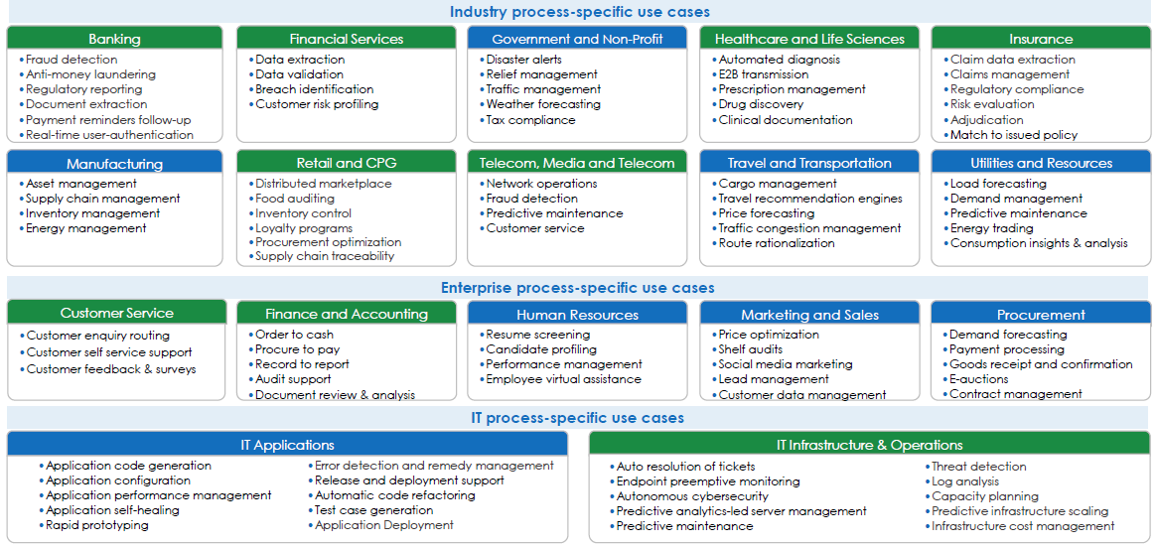
Analytics is all around us….
Source: Avasant Research

Slide 5
What is data analytics
Data or information is in raw format. The increase in size of the data has lead to a rise in need for carrying out inspection, data cleaning, transformation as well as data modeling to gain insights from the data in order to derive conclusions for better decision making process. This process is known as data analysis.
Data Mining is a popular type of data analysis technique to carry out data modeling as well as knowledge discovery that is geared towards predictive purposes.
Business Intelligence operations provide various data analysis capabilities that rely on data aggregation as well as focus on the domain expertise of businesses. In Statistical applications, business analytics can be divided into Exploratory Data Analysis (EDA) and Confirmatory Data Analysis (CDA).

Slide 6
Data Analytics – Sub Streams
Streams Business Analytics – BI (business intelligence), OLAP(online analytical processing) – offline analytic techniques with well defined business objectives
Data Mining - process of sorting through large data sets to identify patterns and establish relationships to solve problems through data analysis.
Real-time Analytics - use of, or the capacity to use, data and related resources as soon as the data enters the system
PIM – Processing in memory: A chip architecture in which the processor is integrated into a memory chip to reduce latency
In-database analytics - a technology that allows data processing to be conducted within the database by building analytic logic into the database itself
In-memory analytics - an approach to querying data when it resides in random access memory (RAM), as opposed to querying data that is stored on physical disks (e.g. Apache Spark)
Massively parallel programming (MPP) -- the coordinated processing of a program by multiple processors that work on different parts of the program, with each processor using its own operating system and memory.
Predictive Analytics - a form of advanced analytics that uses both new and historical data to forecast activity, behavior and trends. It involves applying statistical analysis techniques, analytical queries and automated machine learning algorithms to data sets to create predictive models that place a numerical value -- or score -- on the likelihood of a particular event happening
Text analytics - statistical, linguistic and structural techniques are applied to extract and classify information from textual sources, a species of unstructured data.

Slide 7
Data Analytics
:Business Analytics Types
EDA (Exploratory Data analytics) - aims to find patterns and relationships in data
Business Analytics
Real-time Analytics
Data Mining
CDA (Confirmatory Data analytics) - applies statistical techniques to determine whether hypotheses about a data set are true or false
Predictive Analytics

Slide 8
Data Analytics vs. Data Reporting
Data Analytics
Interactive process of a person tackling a problem, finding the data required to get an answer, analyzing that data, and interpreting the results in order to provide a recommendation for action
Data Reporting
Reporting refers to the process of organizing and summarizing data in an easily readable format to communicate important information.
A report will show the user what had happened in the past to avoid inferences and help to get a feel for the data while analysis provides answers to any question or issue. An analysis process takes any steps needed to get the answers to those questions.
Reporting just provides the data that is asked for while analysis provides the information or the answer that is needed actually.
We perform the reporting in a standardized way, but we can customize the analysis. There are fixed standard formats for reporting while we perform the analysis as per the requirement; we customize it as needed.
We can perform reporting using a tool and it generally does not involve any person in the analysis. Whereas, a person is there for doing analysis and leading the complete analysis process.
Reporting is inflexible while analysis is flexible. Reporting provides no or limited context about what’s happening in the data and hence is inflexible while analysis emphasizes data points that are significant, unique, or special, and it explains why they are important to the business.

Slide 9
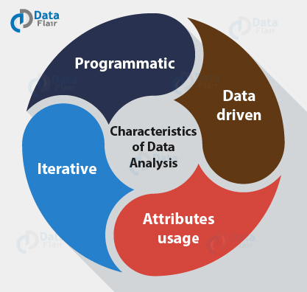
Characteristics of Data Analysis
Programmatic: There might be a need to write a program for data analysis by using code to manipulate it or do any kind of exploration because of the scale of the data.
Data-driven: A lot of data scientists depend on a hypothesis-driven approach to data analysis. For appropriate data analysis, one can also avail the data to foster analysis. This can be of significant advantage when there is a large amount of data. For example – machine learning approaches can be used in place of hypothetical analysis.
Attributes usage: For proper and accurate analysis of data, it can use a lot of attributes. In the past, analysts dealt with hundreds of attributes or characteristics of the data source. With Big Data, there are now thousands of attributes and millions of observations.
4. Iterative: As whole data is broken into samples and samples are then analyzed, therefore data analytics can be iterative in nature. Better compute power enables iteration of the models until data analysts are satisfied. This has led to the development of new applications designed for addressing analysis requirements and time frames.

Slide 10
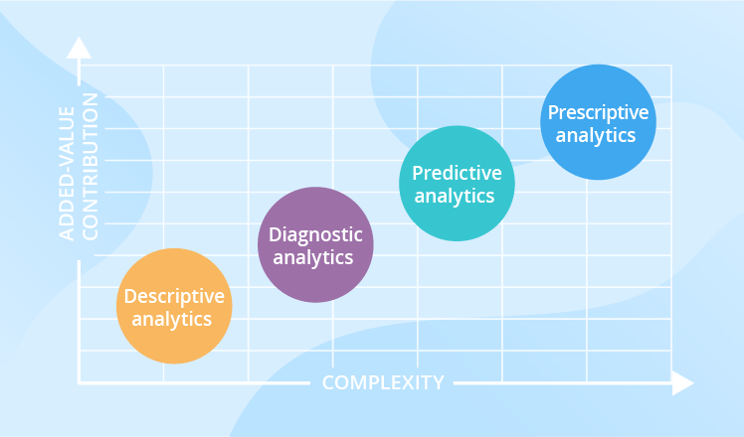
Types of Data Analytics

Slide 11
Types of Data Analytics
Descriptive Analytics
Answers “what happened”
Juggles raw data from multiple data sources to give valuable insights into the past
Diagnostic Analytics
Answers “why something happened”
Find out dependencies and identify patterns
Predictive Analytics
Tells “what’s likely to happen”
Tool for forecasting
Prescriptive Analytics
Prescribe what action to take to eliminate a future problem or take full advantage of a promising trend
Signals that something is wrong or right, without explaining why
Tries to find root cause why something went right or wrong
Predicts or forecast what is likely to happened in future
Uses advanced tools and technologies, like machine learning, business rules and algorithms, which makes it sophisticated to implement and manage.

Slide 12
Applications – Descriptive Analytics
Telecom company finding current trend of MLP customers
Telecom company finding number of site visits for tickets
Healthcare provider learns how many patients were hospitalized last month
Retailer – the average weekly sales volume
Manufacturer – a rate of the products returned for a past month, etc.
A placement agency – number of candidates being placed to top companies, candidates actually joining, candidates who accept but do not join etc.
Consultancy firm – Doing salary analysis of different work streams, stages, industries

Slide 13
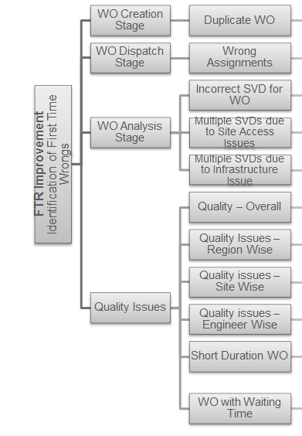
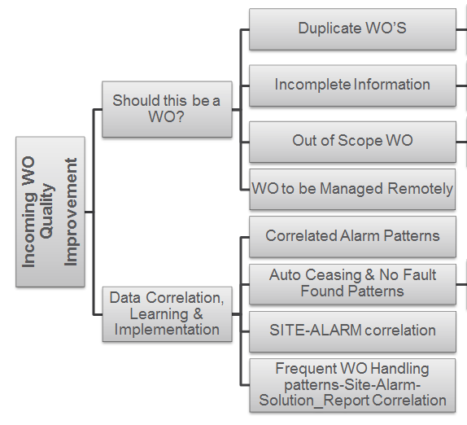
Application - Diagnostic Analytics
FSO analytics example –
Business Objective fro FSO Department: Target for 5 top clients in India, Europe, South Africa and Costa Rica Markets
FTR (Frist Time Right) Improvement by 2%
Improve incoming WO Quality by 5%

Slide 14
Industry Use Cases for Predictive/Prescriptive Analytics: Summary View
Domains | Technique/ Approach / Methodology
 |  | Knowledge Graphs | Neural Networks/ Deep Learning | Natural Language Processing (NLP) | Optimization Algorithms | Image Processing / Computer Vision / Object Recognition | Social Network Analysis
 | Transportation
 | Legal
 | Finance
 | Energy
 | Telecom
 | Logistics
 | Healthcare
 | Sales
 | Security

Slide 15
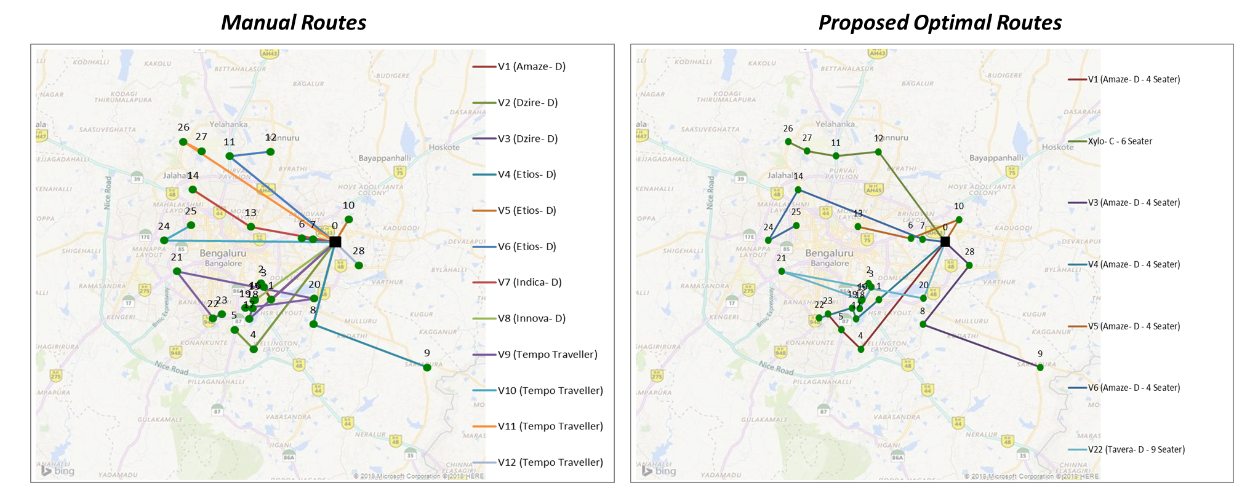
<Transportation/ Logistics><Optimization Algorithms>
Problem Statement
Solution Approach
Solution Benefits
ABC Organization allows employees to request cab service for scheduled time slots, having well-defined drop/pick up locations
Services team manually creates routes for the given requests, which are often sub-optimal
Used Large Neighborhood Search (LNS) – AI Search Metaheuristic
Constraints built into LNS as Rules
Overall Cost Optimization (Fuel, Security) and Travel Time Optimization
No tedious manual planning required; more time window for user requests
Time | Date | Savings | Total No. of Customers | No. of Manual routes | No. of proposed routes | Vehicles used in manual routes | Vehicles used in optimized routes
7:00 PM | 1/19/2018 | 56% | 28 | 12 | 7 | 1 Amaze- D, 2 Dzire D, 3 Etios D,1 Indica D,1 Innova D, 4 Tempo Traveller | 6 Amaze D 4 seater, 1 Tavera D 9 Seater
Notes:
Intelligent Traffic Management – e.g. CMU V2V traffic management system
Logistics – Delivery Route

Slide 16
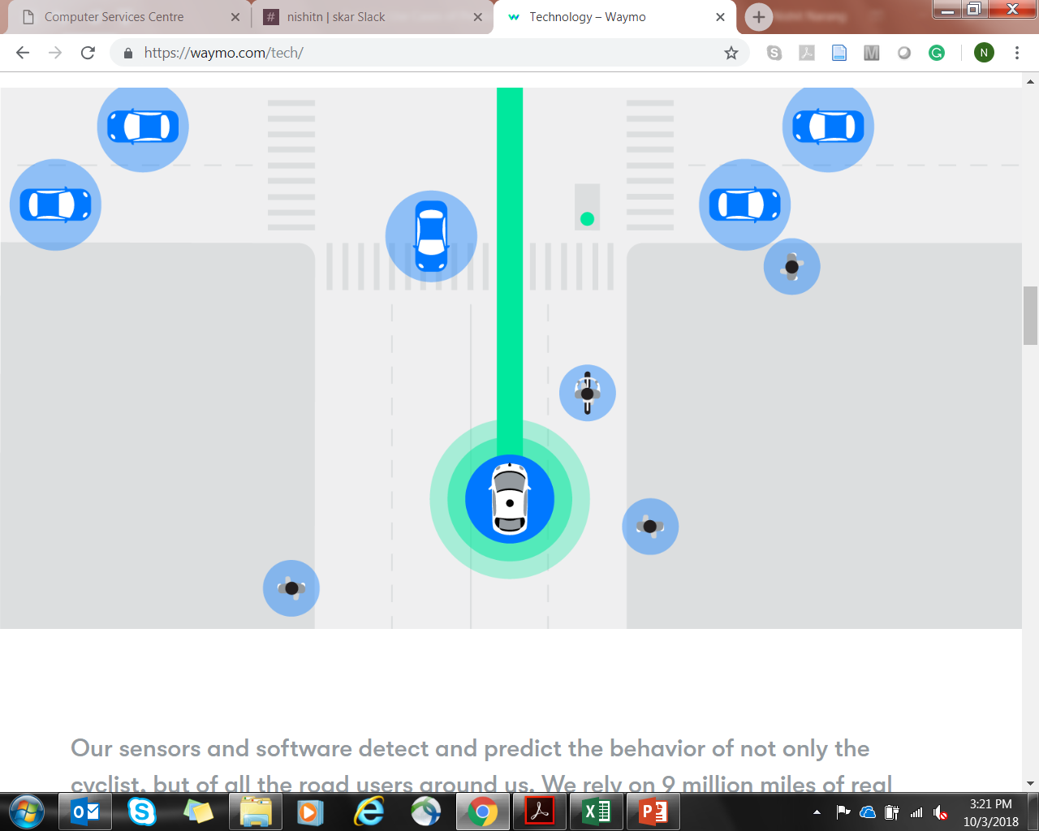
<Transportation><Computer Vision/ Object Recognition>
Problem Statement
Solution Approach
Solution Benefits
94% or more fatalities on road happen due to human error while driving
Computer Vision/ Object Recognition methods to detect pedestrians, cyclists, vehicles, road construction/repair and other events (like road signs, indicators, arm-signals)
Huge volumes of Training data from real world traffic for Predictive Algorithm tuning
Reduced fatalities due to human error, drunken driving and distractions (e.g. mobile phone calls)
Image Source: Waymo

Slide 17
<Sales><Knowledge Graphs + NLP>
Problem Statement
Solution Approach
Solution Benefits
Group company formed via multiple acquisitions (Holding Organization)
NLP-powered Knowledge Management System for easy access of information across divisions of the group company
Stronger sales pitch with information relevant for prospective customer/ project leading to better conversion rates
Information about Clients, Customer Projects, Skills, Expertise distributed across multiple repositories, not easily accessible by the Client/Sales Teams
Lack of knowledge about relevant sales material leading to weaker sales pitch
Efficient Search Engine based on techniques used for Internet search
Information stored as Knowledge Graphs
Notes:
Also, Text Analysis

Slide 18
<Telecom><Social Network Analysis>
Problem Statement
Solution Approach
Solution Benefits
With Telecom saturation in many markets, focus changing from customer acquisition to customer retention. Telecom service providers need to control churn to maintain profitability
Proposed approach uses Social Network Analysis for churn prediction (predict future churners based on direct & indirect interactions with past churners)
Early prediction on possible churners who need to be retained before they churn
Diffusion-based Spreading Activation Algorithm
Start with the churners and their social relationships from the call graph
Initiate a diffusion process with the churners as seeds
Churners influence their neighbors to churn. Influence determined by strength of relationship
At end of the diffusion process examine influence on the non churners
Existing churn prediction systems based on individual calling patterns not efficient
Source: IBM India Research Lab

Slide 19
<Healthcare><Deep Learning>
Problem Statement
Solution Approach
Solution Benefits
WHO estimates 18.1% of adults in the U.S. have experienced an anxiety disorder
A wearable device that extract’s data of your mind in meditative, moving, resting or sleeping states
Better tracking of mental health and cultivation of practices that lead to reduced anxiety and stress
Living in an age of stress, running against time all the while
In India, about 450 million people suffer from mental or behavioral disorder.
In India, the total number of people living with depression is over 56 million, about 4.5% of total population (2015), and another 38 million suffers from anxiety disorders
64 pieces of information extracted and processed to provide useful insights about the state of your mind and overall mental health
Trained model developed by Data Scientists and Neurologists using medical data of existing patients
Real-time tips and guidance to reduce stress and anxiety offered
Notes:
Also, Epidemic Early Warning System and ICU monitoring

Slide 20

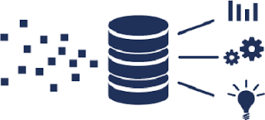

<Telecom><SVM + Learning Algorithms>
Problem Statement
Solution Approach
Solution Benefits
Categorization of historical data on field visits (Duplicate issues, Wrong Assignments, Site Visit Not Required, Site Access Restrictions, Fix Quality)
Advisory inputs for each incoming fault reported to avoid repeated field visits and increased FTR %
Requirement to reduce Field Support costs for Tier-1 Telecom OEM’s operations/support team
First Time Right (FTR) found to be low (30% to 60% across regions), leading to higher # of field visits
Algorithms and Rule-sets to create a learning model. SVM based Prediction to categorize new incoming faults
Data Sampling
Creation of multiple smaller chunks of data-sets
Technology Used-SQL
1.
2.
Data Churning
Identification of dependent and independent variables in data
Relevance of data fields & Variation of values
Completeness & correctness of values in data fields
Technology used – R, SQL, Excel
3.
Build Business Logic
Data Modelling using statistical techniques
Identify relationships between variables
Build algorithm with business logic to derive dependent variables in terms of independent variables
Implement the business logic to run on complete data set
Technology Used- SQL , C#
Technology used – R, SQL

Slide 21
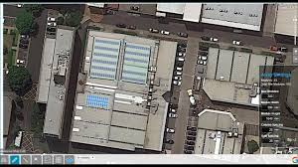

<Energy><Computer Vision/ Image Processing/ Object Recognition>
Problem Statement
Solution Approach
Solution Benefits
Better design for solar plant leading to higher production efficiencies
Upto 25% higher energy production from the same infrastructure, reducing per unit cost of energy
Focus on Renewables Energy Market – Solar Energy farms being setup behind the meter
Higher cost of infrastructure needs to be offset by higher energy production to reduce per unit cost of energy
Drone-based site surveys (video and image feeds) to avoid manual site visits
Computer vision based Design Software to design solar plant layout (Solar PVs)
SVM / Linear Regression based Predictive Analytics using Weather Forecast Data
Early indication of Energy Production for efficiency in Energy Trading & Storage

Slide 22
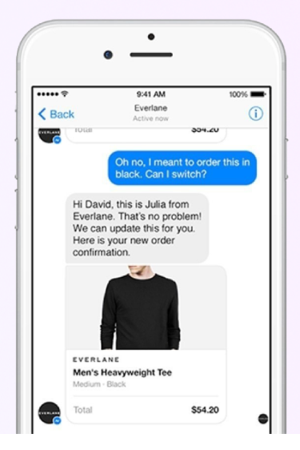
<Sales><NLP+ Knowledge Graphs>
Problem Statement
Solution Approach
Solution Benefits
NLP-powered Chatbots and Voicebots to provide on-chat and on-call customer support
Reduction in customer support costs by upto 30%
E-Commerce firm spending a lot of cost on post-order customer support/ queries
Requirement to maintain round-the-clock customer support center with Multi-lingual executives
Support for English and multiple other Indian languages
Handover to human executive only for the cases that cannot be handled by Bots
Source: Litifer

Slide 23
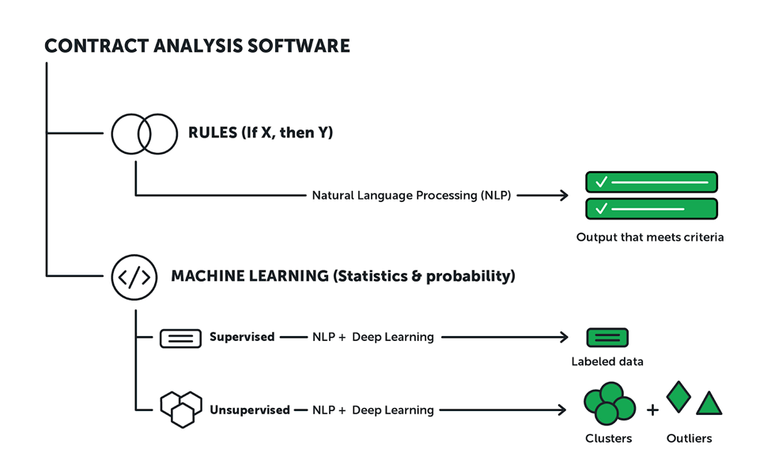
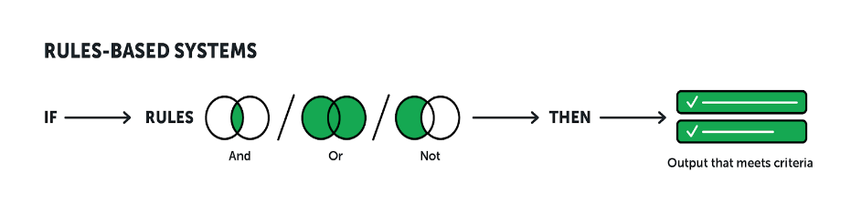
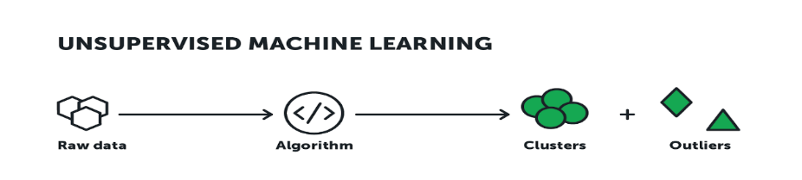
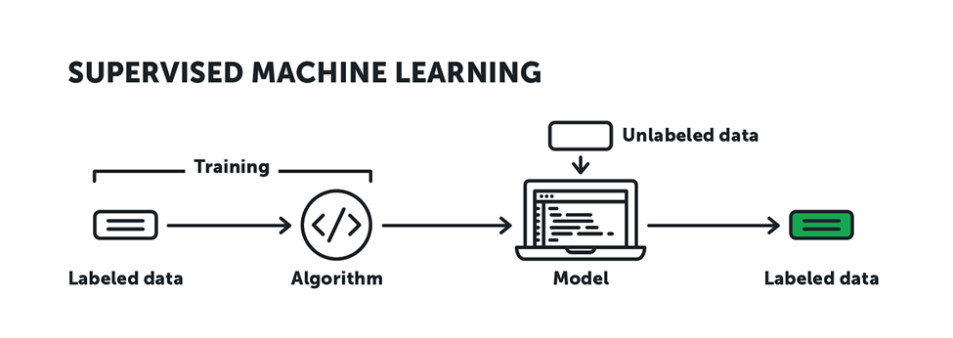
<Legal><NLP, Computer Vision & Deep Learning>
Problem Statement
Solution Approach
Solution Benefits
Longer and error prone process for Contract Review and Due Diligence
Using LegalTech, an AI-based solution. Two categories of solutions:
Systems that apply predetermined rules
Less overhead costs of Business
Requirement of Legal experts and a significantly large Legal Team
Systems that learn by training themselves
Faster contract processing time

Slide 24
<Finance><Neural Networks / Deep Learning>
Problem Statement
Solution Approach
Solution Benefits
Stock market portfolio selection to maximize expected return, while minimizing risk
Implement Markowitz’s Modern Portfolio Theory:
Stock Price prediction using Deep Learning models using TensorFlow
Optimized Risk-Reward Trade-off & Effective Portfolio Management
Use of Long short-term memory (LSTM) networks, which are special kind of Recurrent Neural Network (RNN) capable of learning long-term dependencies
Risk computed by calculating Standard Deviation on historical data
Portfolio weights for different stocks calculated using Logistic Regression technique
Notes:
Other use cases include Fraud Detection and Prevention

Slide 25



<Security><Computer Vision/ Image Processing/ Object Recognition>
Problem Statement
Solution Approach
Solution Benefits
Automated monitoring of all live CCTV feeds from multiple cameras
Better incident reporting and reduced manual monitoring required
Security staff required round-the-clock to monitor CCTV footages from multiple cameras
Incidents / Security lapses getting missed and not reported
Configurable list of events/ incidents that need to be watched and/or reported
Conversion of detailed feeds into highlights for quick “end-of-day” watch

Slide 26
Analytics Terminology
https://marketing.adobe.com/resources/help/en_US/reference/glossary.html
https://analyticstraining.com/analytics-terminology/
https://blog.hubspot.com/marketing/hubspot-google-analytics-glossary

Slide 27
Skills Required for Data Analyst
Technical skills for data analytics:
Packages and Statistical methods
BI Platform and Data Warehousing
Base design of data
Data Visualization and munging
Reporting methods
Knowledge of Hadoop and MapReduce
Data Mining
Business Skills Data analytics:
Effective communication skills
Creative thinking
Industry knowledge
Analytic problem solving

Slide 28
Tools in Data Analytics – Paid Tools
SAS: SAS is a software suite that can mine, alter, manage and retrieve data from a variety of sources and perform statistical analysis on it. SAS provides a graphical point-and-click user interface for non-technical users and more advanced options through the SAS programming language. SAS programs have a DATA step, which retrieves and manipulates data, usually creating a SAS data set, and a PROC step, which analyses the data.
WPS: WPS can use programs written in the language of SAS without the need for translating them into any other language. In this regard WPS is compatible with the SAS system. WPS is a language interpreter able to process the language of SAS and produce similar results. It is sometimes used as an alternative to SAS as it is relatively cheaper.
MS Excel: Microsoft Excel is a spreadsheet application developed by Microsoft for Microsoft Windows and Mac OS. It features calculation, graphing tools, pivot tables, and a macro programming language called Visual Basic for Applications. It has been a very widely applied spreadsheet for these platforms, especially since version 5 in 1993, and it has replaced Lotus 1-2-3 as the industry standard for spreadsheets. Excel forms part of Microsoft Office

Slide 29
Tools in Data Analytics – Paid Tools contd..
Tableau: Tableau Software is an American computer software company headquartered in Seattle, Washington. It produces a family of interactive data visualization products focused on business intelligence. Tableau offers five main products: Tableau Desktop, Tableau Server, Tableau Online, Tableau Reader and Tableau Public.
Pentaho: Pentaho is a company that offers Pentaho Business Analytics, a suite of open source Business Intelligence (BI) products which provide data integration, OLAP services, reporting, dash boarding, data mining and ETL capabilities. Pentaho was founded in 2004 by five founders and is headquartered in Orlando, FL, USA. The Pentaho suite consists of two offerings, an enterprise and community edition. The enterprise edition contains extra features not found in the community edition.
Statistica: STATISTICA is a statistics and analytics software package developed by StatSoft. STATISTICA provides data analysis, data management, statistics, data mining, and data visualization procedures. STATISTICA product categories include Enterprise (for use across a site or organization), Web-Based (for use with a server and web browser), Concurrent Network Desktop, and Single-User Desktop.

Slide 30
Tools in Data Analytics – Paid Tools contd..
Qlikview : Qlikview is a business intelligence software from Qlik. It helps its users understand the business in a better way by providing them features like consolidating relevant data from multiple sources, exploring the various associations in the data, enabling social decision making through secure, real-time collaboration etc.
KISSmetrics : KISSmetrics is a person-based analytics product that helps users identify, understand, and improve the metrics that drive their online business. They make it simple to get the information users need to make better product and marketing decisions.

Slide 31
Tools in Data Analytics – Paid Tools contd..
WeKa :The Weka workbench contains a collection of visualization tools and algorithms for data analysis and predictive modelling, together with graphical user interfaces for easy access to this functionality. The original non-Java version of Weka was a TCL/TK front-end to (mostly third-party) modelling algorithms implemented in other programming languages, plus data pre-processing utilities in C, and a Make file-based system for running machine learning experiments. This original version was primarily designed as a tool for analysing data from agricultural domains, but the more recent fully Java-based version (Weka 3), for which development started in 1997, is now used in many different application areas, in particular for educational purposes and research.
BigML: BigML is a Corvallis, Ore.based startup with a SaaS-based machine learning platform that allows everyday business users to create actionable predictive models within minutes.

Slide 32
Tools in Data Analytics – Free Tools
R : R provides a wide variety of statistical and graphical techniques, including linear and nonlinear modelling, classical statistical tests, time-series analysis, classification, clustering, and others. R is easily extensible through functions and extensions, and the R community is noted for its active contributions in terms of packages. There are some important differences, but much code written for S runs unaltered. Many of R's standard functions are written in R itself, which makes it easy for users to follow the algorithmic choices made. For computationally intensive tasks, C, C++, and FORTRAN code can be linked and called at run time. Advanced users can write C, C++, Java or Python code to manipulate R objects directly.
Google Analytics: Google Analytics is a service offered by Google that generates detailed statistics about a website's traffic and traffic sources and measures conversions and sales. The product is aimed at marketers as opposed to webmasters and technologists from which the industry of web analytics originally grew. It's the most widely used website statistics service

Slide 33
Tools in Data Analytics – Free Tools contd..
Python Pandas (python data analysis library) is an open source, BSD-licensed library providing high-performance, easy-to-use data structures and data analysis tools for the Python programming language. It provides tools for reading and writing data between in-memory data structures and different formats: CSV and text files, Microsoft Excel, SQL databases, and the fast HDF5 format and also intelligent data alignment and integrated handling of missing data: gain automatic label-based alignment in computations and easily manipulate messy data into an orderly form can be done using python
Spotfire TIBCO Spotfire is an analytics and business intelligence platform for analysis of data by predictive and complex statistics. During the 2010 World Cup, FIFA used this software to give viewers analytics on country teams' past performances.

